Slide 1

Every dealership eventually reaches
a decision that changes everything.
CONFIDENTIAL EXECUTIVE BRIEFING
ROB SMITH | CONFIDENTIAL EXECUTIVE ADVISORY
01

Slide 2

Some decisions create
extraordinary value.
Others destroy it.
When the stakes are high, another experienced perspective can change the outcome.
ROB SMITH | CONFIDENTIAL EXECUTIVE ADVISORY
02

Slide 3

The difference is rarely information.
It's judgment.
CONFIDENTIAL • INDEPENDENT • OPERATOR-LED
ROB SMITH | CONFIDENTIAL EXECUTIVE ADVISORY
03

Slide 4

ROB SMITH
CONFIDENTIAL EXECUTIVE ADVISORY
Helping automotive leaders make better decisions, build stronger businesses, and gain access to the expertise and innovation needed to succeed.
There Isn't a Language
in Automotive
We Don't Speak.
ROB SMITH | CONFIDENTIAL EXECUTIVE ADVISORY
04

Slide 5
WHY EXECUTIVE ADVISORY
Every owner needs a confidential sounding board.
Not a program. Not a lecture. A private, experienced voice at the table when the decision matters most.
Experience
Judgment
Confidentiality
Four decades across automotive retail, finance, acquisitions, and capital.
Clear perspective for decisions that affect profitability and enterprise value.
Every conversation is private. Every recommendation is independent. Every decision remains yours.
Some of the best business decisions are made quietly.
ROB SMITH | CONFIDENTIAL EXECUTIVE ADVISORY
05

Slide 6
THE DECISIONS THAT MATTER MOST
When the stakes are high, experience matters.
Growth
Profitability
Succession
Should we expand, consolidate, or reposition?
Where is cash leaking and value hiding?
Who leads the next chapter?
Acquisitions
Technology
Capital
Should we buy, sell, or walk away?
What should we adopt now—and what is noise?
How do we fund growth without losing control?
ROB SMITH | CONFIDENTIAL EXECUTIVE ADVISORY
06

Slide 7

WE'VE SAT ON YOUR SIDE OF THE DESK
This is operator experience, not theory.
We’ve been where you are.
Dealer Principal
Borrower
Lender
Operator
Investor
Negotiator
Acquirer
Capital Partner
That is why we understand yours.
ROB SMITH | CONFIDENTIAL EXECUTIVE ADVISORY
07

Slide 8
EXPERIENCE AT A GLANCE
Fluent across automotive and automotive finance.
A lifetime of operating experience distilled into better decisions for owners, investors, lenders, and operators.
40+
$3B+
Dealer
Every Side
Years in automotive retail, finance and operating leadership
Automotive finance originations and portfolio activity
Former franchised dealer principal and lifelong operator
Dealer • lender • investor • acquirer • operator
We have closed deals others thought were dead—and financed transactions others believed could not be financed.
ROB SMITH | CONFIDENTIAL EXECUTIVE ADVISORY
08

Slide 9
THE EXECUTIVE CONFIDENCE PROCESS
A simple process for complex decisions.
01
Listen
02
Evaluate
03
Challenge
04
Prioritize
05
Execute
Understand the owner's goals, pressures, and priorities.
Review the business through an enterprise lens.
Test assumptions and identify blind spots.
Focus on the few levers that matter most.
Build a practical roadmap and accountability rhythm.
We do not try to solve every problem in a day. We identify the problems that matter most—and build the roadmap to solve them.
ROB SMITH | CONFIDENTIAL EXECUTIVE ADVISORY
09

Slide 10
EXECUTIVE STRATEGY INTENSIVE
The first day is about clarity.
The most important work happens one-on-one with the owner or GM. The objective is not an audit. The objective is to identify the highest-impact decisions.
Before Arrival
Morning
Midday
Confidential strategy call and requested operating/financial information.
Owner/GM session: goals, frustration points, blind spots, and priorities.
Walk the store, observe operations, meet key leaders, gather context.
Afternoon
Close
After
Leadership conversations and enterprise opportunity assessment.
Executive debrief: immediate wins, 30-day priorities, and next steps.
Executive Summary plus follow-up strategy call.
ROB SMITH | CONFIDENTIAL EXECUTIVE ADVISORY
10

Slide 11
ENTERPRISE PERFORMANCE LENS
We do not evaluate departments. We evaluate businesses.
Leadership & Culture
Variable Operations
F&I
Accountability, decision-making, staffing, rhythm.
Sales process, inventory, pricing, recon, digital retail.
Product penetration, lender mix, compliance, funding.
Fixed Operations
Finance Company
Enterprise Value
Service, parts, collision, absorption, retention.
Underwriting, collections, delinquencies, recovery.
Capital, acquisitions, succession, growth strategy.
The goal is not another report. The goal is a stronger, more valuable business.
ROB SMITH | CONFIDENTIAL EXECUTIVE ADVISORY
11

Slide 12

FIXED OPERATIONS MATTER
Service, parts and collision are often the engine.
Sales may bring the customer in. Fixed Operations builds lasting value.
Service
Productivity • Proficiency • ELR • Hours/RO • CSI • Absorption
Parts
Turn rate • Obsolescence • Fill rate • Inventory controls • Wholesale
Collision
Cycle time • Touch time • Supplements • DRP • Gross • Capacity
ROB SMITH | CONFIDENTIAL EXECUTIVE ADVISORY
12

Slide 13
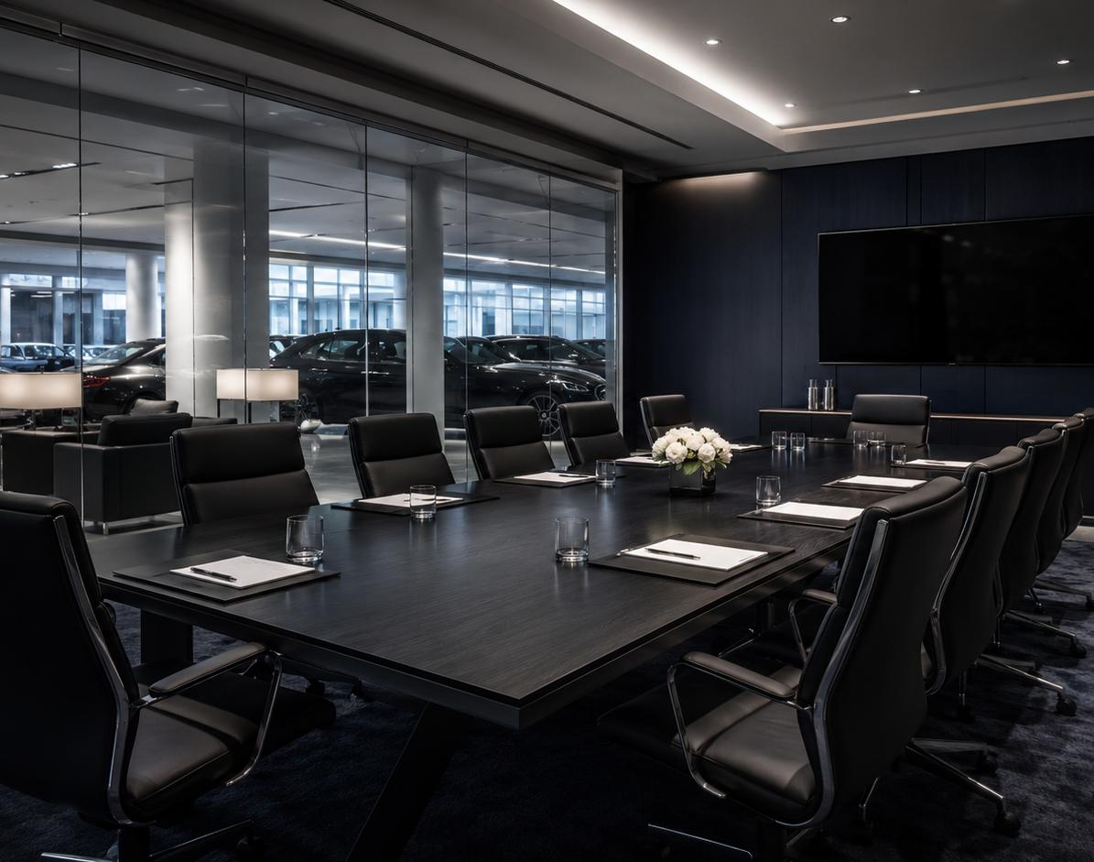
EXPERIENCE MEETS INNOVATION
Today’s dealerships need more than advice. They need access.
When specialized expertise is needed, we bring the right people to the table.
The Global Network
AI & Automation
CRM & Customer Engagement
F&I Specialists
Sales Trainers
Fixed Ops Leaders
Capital Strategy
M&A Resources
ROB SMITH | CONFIDENTIAL EXECUTIVE ADVISORY
13

Slide 14

Relationships built on trust
are rarely advertised.
✓ Confidentiality agreement if requested
✓ Private executive sessions
✓ No public references without permission
✓ No social media or client disclosure
✓ Independent recommendations
✓ Every decision remains yours
Some of the best business decisions are made quietly.
ROB SMITH | CONFIDENTIAL EXECUTIVE ADVISORY
14

Slide 15
ENGAGEMENT INVESTMENT
Executive Strategy Intensive
$5,000
Designed for owners
Built for decisions
Dealer Principals, GMs, dealer groups, automotive entrepreneurs, investors, and family offices.
Growth, acquisitions, succession, profitability, technology, leadership, finance, and capital.
+ reasonable travel expenses
Includes pre-call, full on-site day, executive debrief, written summary, and follow-up strategy call.
Path to more value
If deeper work is needed, we bring the right specialist or structure ongoing advisory support.
ROB SMITH | CONFIDENTIAL EXECUTIVE ADVISORY
15

Slide 16
Better Decisions.
Stronger Businesses.
Trusted Relationships.
Rob Smith
Confidential Executive Advisory
410 Long Branch Way • Canton, GA 30115
770-335-5670 • Rob@KingsgateCapitalPartners.com
Let's have a confidential conversation.

